Slide 1

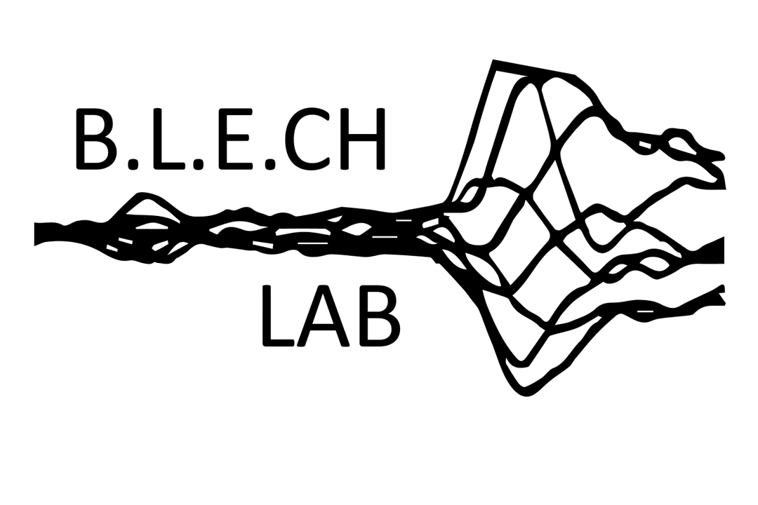
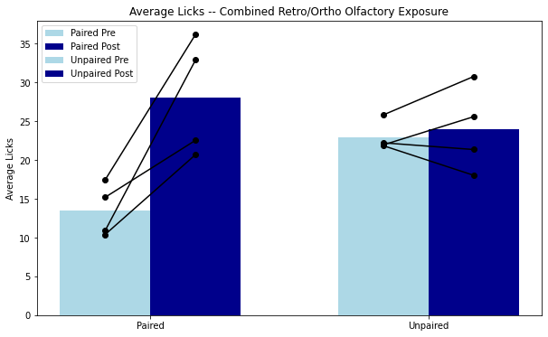
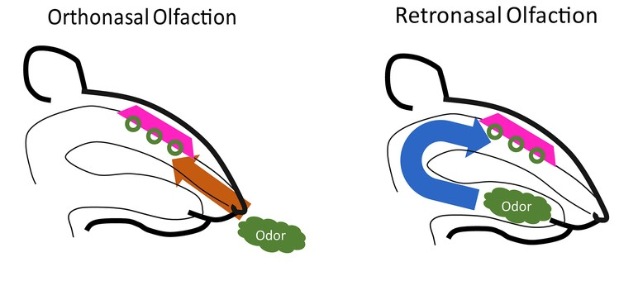

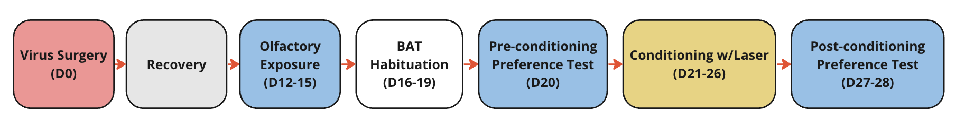
Olfactory Exposure Strengthens Preference Learning in a Cortically Dependent Manner
Isaac Goldstein¹, Aishwarya Surendran¹, Donald Katz^{1,2,3}, Kathleen Maigler¹, and Thomas Gray¹
1. Neuroscience Program 2. Psychology Department, Brandeis University, Waltham, MA 3. Volen National Center for Complex Systems
Introduction
OE causes an increase in preference learning
GC inhibition prevents taste potentiated preference learning
Olfaction can best be thought of as a “dual sense”, in that odors can make their way to the nasal epithelium by either of 2 routes.
Though olfactory experience is conventionally thought of in terms of orthonasal delivery (i.e., through the nose), rats learn an odor-reward association preference learning task faster when the odor is retronasally experienced (through the mouth; Blankenship et al., Curr Biol., 2019).
1
Orthonasal Olfaction
Retronasal Olfaction
Adapted from Blankenship et al., 2019
Figure 1. (Left) Visual depiction of orthonasal olfaction in rats. (Right) Visual depiction of retronasal olfaction in rats.¹
Ortho OE does not affect preference learning
Viral expression influences preference learning exponentially
Our previous results demonstrate that rats trained after OE develop a significantly stronger preference for the paired odor than unexposed rats (n=12, 6 per group).
It is plausible that the Gustatory Cortex plays a large role in processing the experiences presented by combined olfactory pre-exposure, and throughout an animal’s learning process.
Objectives
Given that retro preference learning, and taste pre-exposure are both gustatory cortex (GC) dependent, we test whether the enhancement of this learning from prior OE is also dependent on GC.
We hypothesize that optogenetically inhibiting GC function during learning will prevent the OE-induced potentiated learning we see without viral inhibition, resulting in rats having a similar preference for the paired and unpaired odor regardless of prior OE.
The next steps in my experiment are to have a squad of rats perform this task with retronasal olfaction alone to determine whether orthonasal olfaction influences ILIs and onset of the first lick during the Brief Access Task (BAT). ²
Future experiments may aim to include more methods such as viral injection to optogenetically inhibit taste cortex and electrophysiological recording to characterize differences in ortho and retronasal olfaction.
Future Directions and Discussion
Approach
Experimental Design
Experimental Groups
5 EE combined retro/ortho (TG29-32; TG38)
5 UE combined retro/ortho (TG33-37)
4 UE ortho (TG39-42), 4 EE ortho (TG43-46)
4 UE retro (TG47-50), 4 EE retro (TG51-54)
2 EE combined retro/ortho- GCx (AAV-CAG-ArchT-GFP)
2 UE combined retro/ortho - GCx (AAV-CAG-ArchT-GFP)
1 EE combined retro/ortho - GC intact
1 UE combined retro/ortho – GC intact
Rats were water deprived and ran through a brief access task conditioning phase, followed by a training paradigm sandwiched in between two preference tests.
The differences lie in whether or not OE was given, and if GCx took place
Figure 4: The BAT rig contains one shutter, programmed to open and close for the delivery of solutions in a randomized order. The rack with solutions slides along and specific solutions will align with the shutter once called upon.
Acknowledgments & Citations
Firstly, I would like to thank Donald Katz for the opportunity to conduct this research project and continuous mentorship throughout the process. I would also like to thank my graduate student advisor, Thomas Gray, for his help and mentorship throughout the experimental design and data analysis process. I am grateful to our post-doctorate Jian-You Lin for his help with developing code for the cluster analysis, and to Kathleen Maigler for help with the BAT rig experimental process. Finally, I would like to thank the Katz Lab for their help and guidance throughout this project. This research was completed at Brandeis University. The Brandeis campus sits on land that was sacred to the Massachusett nation, including four tribes existing today: the Mattakeeset, Natick, Ponkapoag, and Namasket. Both Native Americans and Africans were enslaved in the colony of Massachusetts.
[1] Blankenship et al., 2019. doi:10.1016/j.cub.2018.11.011; [2] Davis 1973. doi: 10.1016/0031-9384(73)90120-0. [3] Zhou et al., 2022. doi: 10.3389/fnmol.2022.988914
Figure : Post surgery, the rats recover until they are introduced to OE in their home cages. Animals that do not receive OE continue regular water consumption through the OE phase. The BAT habituation phase consists of two days of acclimation in the BAT rig (without licking), and two days with water lick trials. Pre and post conditioning preference tests sandwich the animal’s learning phase, in which the laser is activated.

